Slide 1
Gothic Literature
Here is where your presentation begins

Slide 2
Contents of this template
You can delete this slide when you’re done editing the presentation
Fonts | To view this template correctly in PowerPoint, download and install the fonts we used
Used and alternative resources | An assortment of graphic resources that are suitable for use in this presentation
Thanks slide | You must keep it so that proper credits for our design are given
Colors | All the colors used in this presentation
Icons and infographic resources | These can be used in the template, and their size and color can be edited
Editable presentation theme | You can edit the master slides easily. For more info, click here
For more info:
Slidesgo | Blog | Faqs
You can visit our sister projects:
Freepik | Flaticon | Storyset | Wepik | Videvo

Slide 3
Table of contents
01.
02.
03.
04.
05.
06.
Introduction
Features
Themes
You can describe the topic of the section here
You can describe the topic of the section here
You can describe the topic of the section here
Symbolism
Authors
Activities
You can describe the topic of the section here
You can describe the topic of the section here
You can describe the topic of the section here

Slide 4
01.
Introduction
You can enter a subtitle here if you need it

Slide 5
Whoa!
This can be the part of the presentation where you introduce yourself, write your email…

Slide 6
Introduction to gothic literature
Mercury is the closest planet to the Sun and the smallest one in the entire Solar System. Contrary to popular belief, this planet's name has nothing to do with the liquid metal. Mercury was, instead, named after the famous Roman messenger god Mercurius
Mercury takes a little more than 58 days to complete its rotation, so try to imagine how long days must be there! Since the temperatures are so extreme, albeit not as extreme as on Venus, Mercury has been deemed to be non-habitable for humans

Slide 7
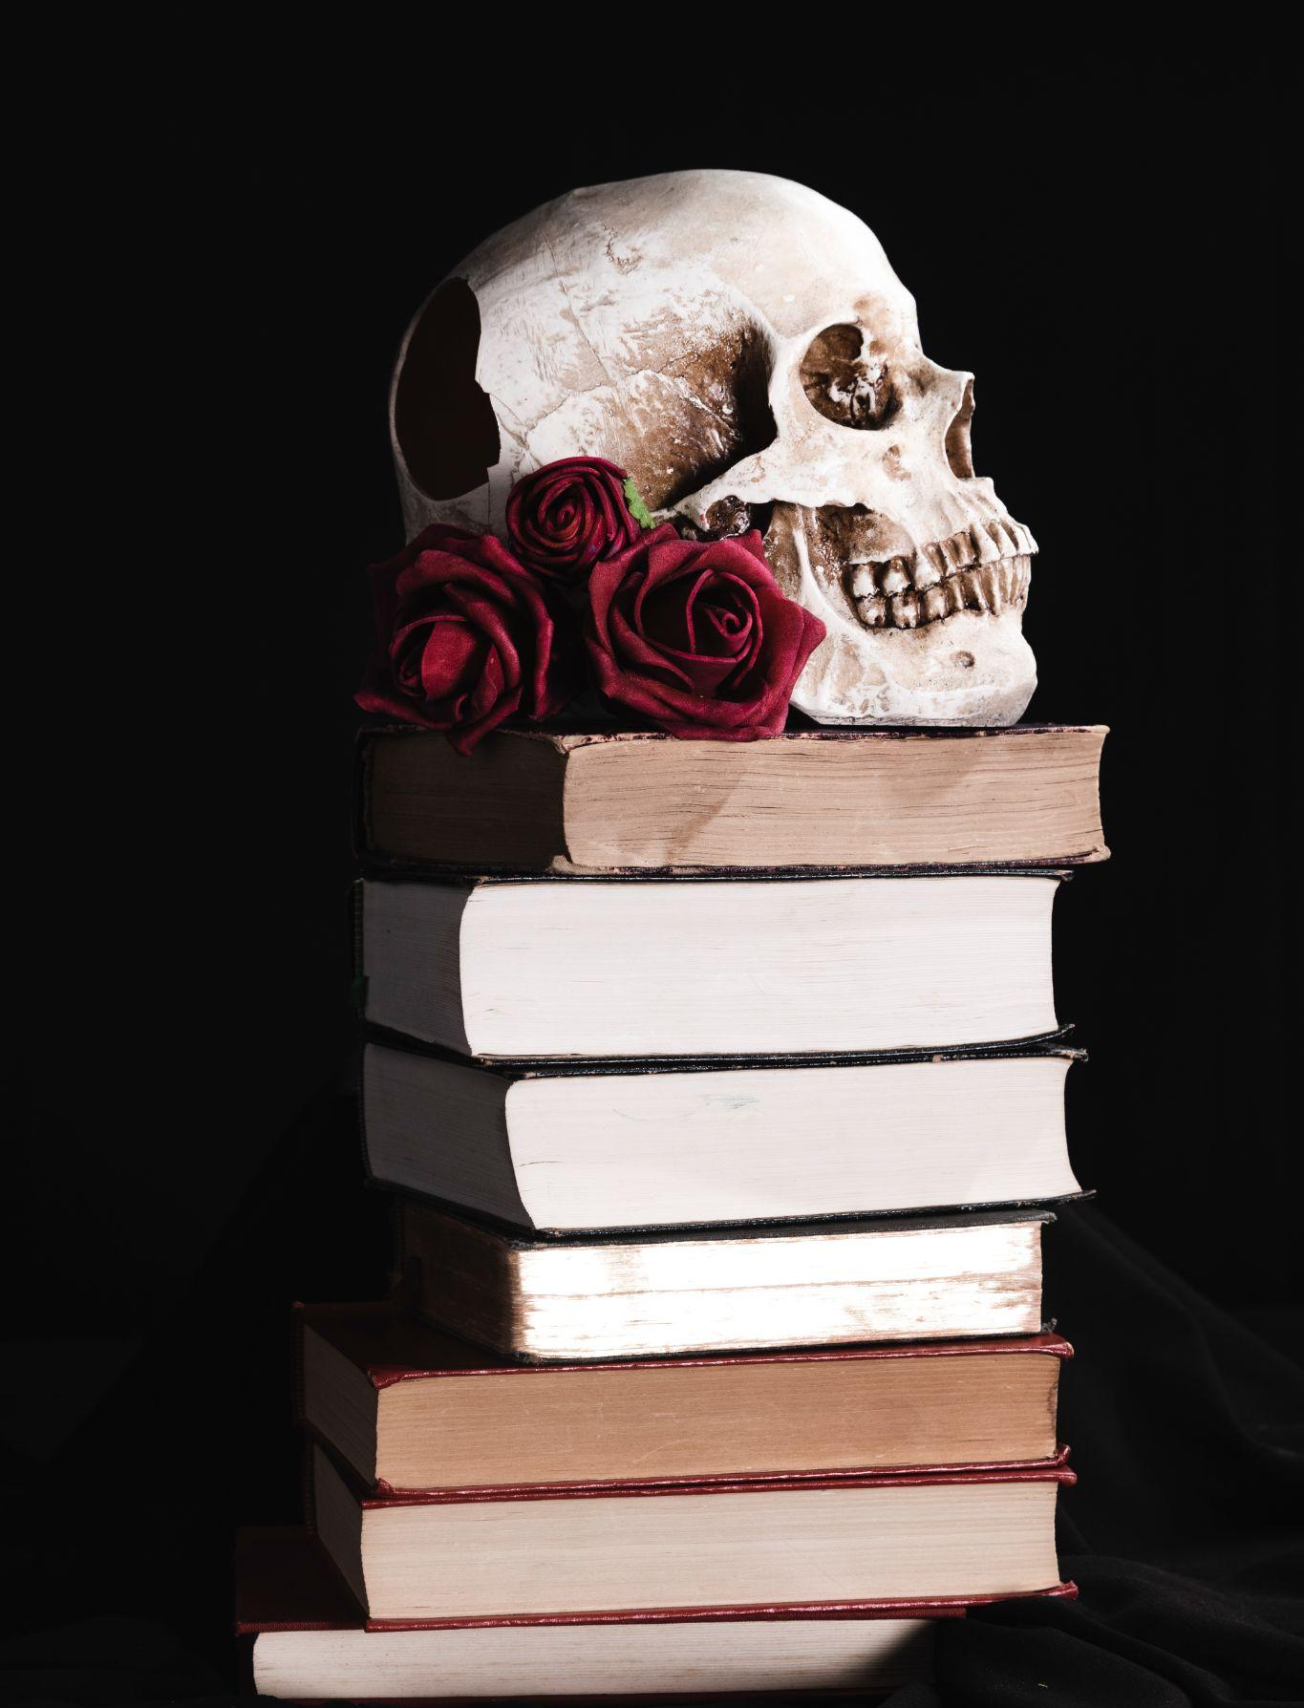
Historical context:
The gothic revival
Do you know what helps you make your point crystal clear? Lists like this one:
They’re simple
You can organize your ideas clearly
You’ll never forget to buy milk!
And the most important thing: the audience won’t miss the point of your presentation

Slide 8
Origins
The beginning
Next decades
Mercury is the closest planet to the Sun and the smallest one in the Solar System—it’s only a bit larger than the Moon
Venus has a beautiful name and is the second planet from the Sun. It’s hot and has a poisonous atmosphere

Slide 9
Features of gothic literature
Atmosphere
Emphasis
Tension
Mercury is the closest planet to the Sun and the smallest of them all
Venus has a beautiful name and is the second planet from the Sun
Despite being red, Mars is actually a cold place. It’s full of iron oxide dust

Slide 10
Gothic themes
The uncanny
Duality of human nature
Venus has a beautiful name, but also high temperatures
Despite being red, Mars is actually a cold place. It’s full of iron oxide dust
Isolation and madness
The macabre and morbid
Jupiter is a gas giant and the biggest planet in the Solar System
Mercury is the closest planet to the Sun and the smallest of them all

Slide 11
Symbolic elements in gothic literature
Candles
Mirrors
Labyrinths
Mars is actually a very cold place
Venus has extremely high temperatures
Neptune is the farthest planet from the Sun
Red roses
Storm
Ruins
Mercury is the closest planet to the Sun
Saturn is a gas giant and has several rings
Jupiter is the biggest planet of them all

Slide 12
Awesome words

Slide 13
—Someone Famous
“This is a quote, words full of wisdom that someone important said and can make the reader get inspired”

Slide 14
9h 55m 23s
333,000
386,000 km
Jupiter’s rotation period
The Sun’s mass compared to Earth’s
Distance between Earth and the Moon

Slide 15
Recurring themes in Gothic literature
25%
50%
75%
Supernatural elements
Death and
decay
Mental
problems
Mercury is the closest planet to the Sun and the smallest of them all
Venus has a beautiful name and is the second planet from the Sun
Despite being red, Mars is actually a cold place. It’s full of iron oxide dust

Slide 16
Phone mockup
You can replace the image on the screen with your own work. Just right-click on it and select “Replace image”

Slide 17
Where did gothic literature born?
It was born in...
Gothic literature emerged in 18th-century England, initiated by Horace Walpole's "The Castle of Otranto," combining elements of romance, horror, and mystery, shaping a lasting literary genre.

Slide 18
Timeline of the most famous books
XXXX
XXXX
XXXX
XXXX
Name of
the book
Name of
the book
Name of
the book
Name of
the book
Mars is actually a very cold place
Venus has extremely high temperatures
Jupiter is the biggest planet of them all
Saturn is a gas giant and has several rings

Slide 19
Types of gothic literature
Controversy
Novel
Drama
Art
Satire
Terror

Slide 20
Use tables to represent data
 | Author | Year | Description
Book 1 | Author | XXXX | Insert a little resume here
Book 2 | Author | XXXX | Insert a little resume here
Book 3 | Author | XXXX | Insert a little resume here
Book 4 | Author | XXXX | Insert a little resume here
Book 5 | Author | XXXX | Insert a little resume here

Slide 21
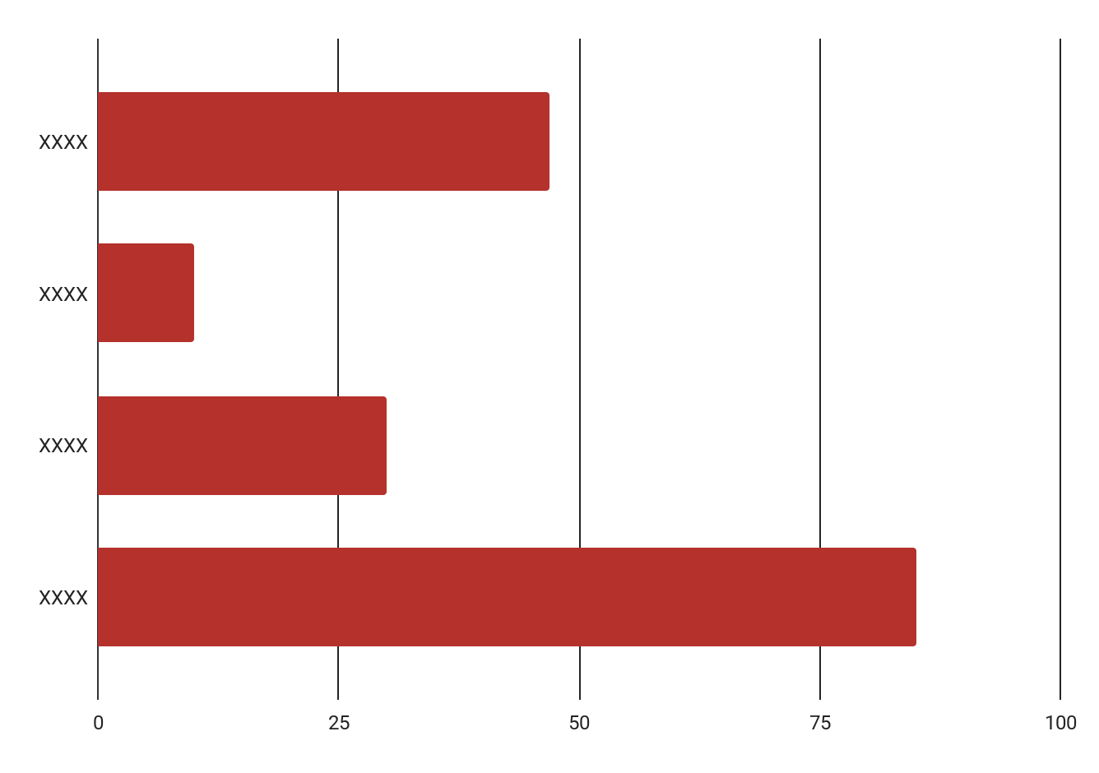
Adepts of gothic literature in years
xxxx
xxxx
xxxx
xxxx
Mercury is quite a small planet
Venus has very high temperatures
Jupiter is an enormous planet
Saturn is a gas giant with rings
Follow the link in the graph to modify its data and then paste the new one here. For more info, click here

Slide 22
Symbolic elements in gothic literature
01
Candles and lanterns
Illumination in the darkness, representing knowledge, revelation, and a contrast between light and shadow
02
Mist and fog
Obscures vision, creating a sense of mystery, foreboding, and the unknown
03
Skulls and skeletons
Reminders of mortality, emphasizing the theme of death and the macabre
04
Red roses
Represents love, but in the gothic context, it may symbolize forbidden or tragic love

Slide 23
The most famous authors
XXXX | Author’s name | Brief description about the author here
XXXX | Author’s name | Brief description about the author here
XXXX | Author’s name | Brief description about the author here
XXXX | Author’s name | Brief description about the author here
XXXX | Author’s name | Brief description about the author here
XXXX | Author’s name | Brief description about the author here

Slide 24
Different periods of gothic literature
First period
They sought to experience forbidden sensations and escape from daily routine
Evolution of gothic genre
Second period
The gothic period reached its full maturity in the nineties in the form of great novels.
Third period
The classic Gothic novels give way to a Gothic influenced by different emerging currents

Slide 25
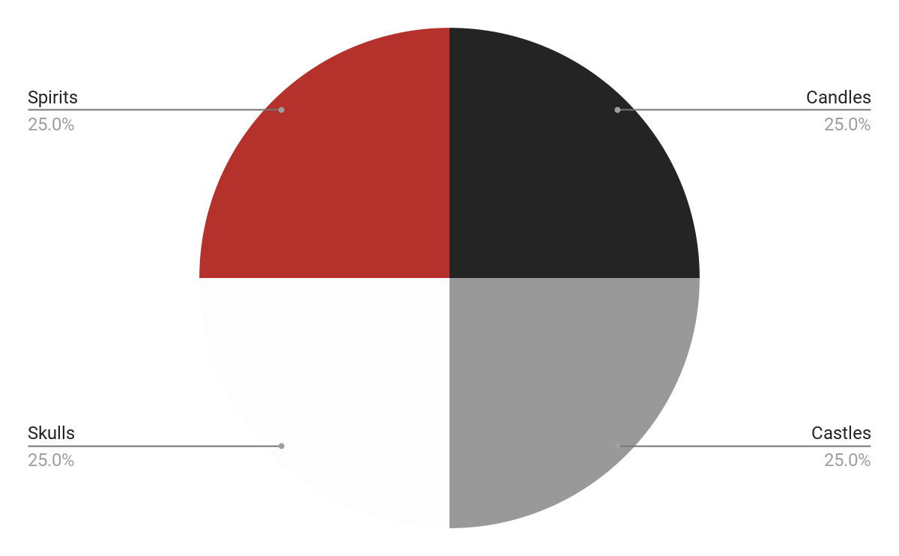
The topics more used in this genre
25% | Spirits | Pluto is now considered a dwarf planet
25% | Skulls | Ceres is located in the main asteroid belt
25% | Castles | Neptune is very far away from us
25% | Candles | Mercury is a small planet
Follow the link in the graph to modify its data and then paste the new one here. For more info, click here

Slide 26
Activity 1: Answer and questions
During which historical period did Gothic literature emerge and gain popularity?
a) Renaissance | c) Victorian era
b) Industrial Revolution | d) 18th-century
What atmospheric phenomenon is commonly employed in Gothic literature?
a) Aurora Borealis | c) Rainbow
b) Thunderstorms | d) Solar Eclipse
What cultural movement influenced the development of Gothic literature?
a) Romanticism | c) Enlightenment
b) Baroque | d) Impressionism
What term is used to describe a gloomy, eerie setting in Gothic literature?
a) Utopia | c) Dystopia
b) Elysium | d) Atmosphere

Slide 27
Activity 3: Write a story with this words
Castle, mystery, ghost, adventure, hidden passages, magic, brave kids, secret door, ancient curse, lantern, spooky, treasure, enchanted, shadows, midnight, whispers, key,laughter, moonlight
The history beginning here…

Slide 28
Thanks!
Do you have any questions?
youremail@freepik.com
+34 654 321 432
yourwebsite.com
Please keep this slide for attribution

